Slide 1

SOME APPLICATIONS
OF TRIGONOMETRY
Introduction
Notes:
School
1

Slide 2
Module 1

Slide 3
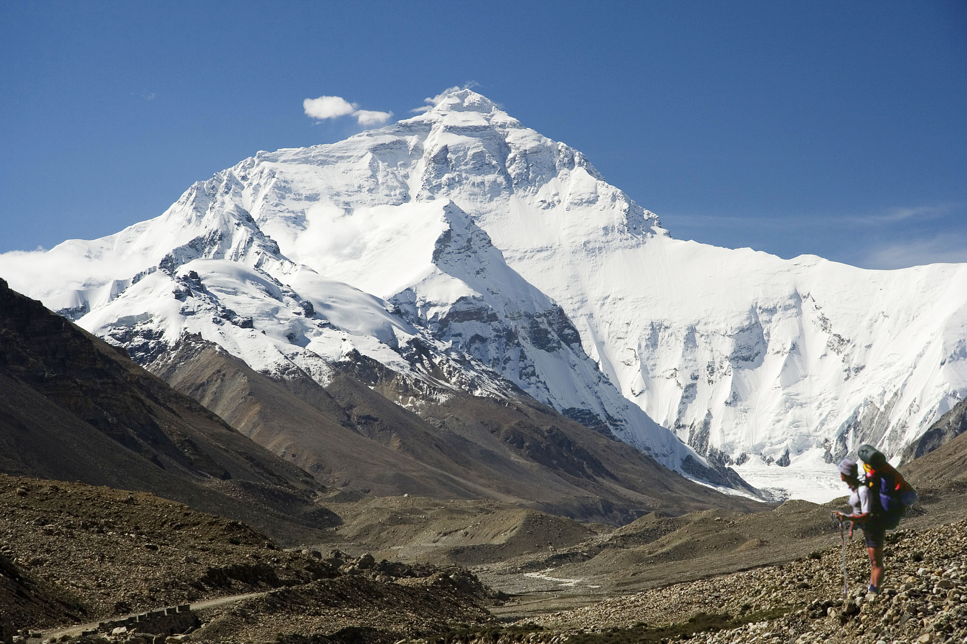
MOUNT EVEREST
It is impossible to measure it with the help of a measuring tape.
?
How can we measure it ?
What is its height ?

Slide 4
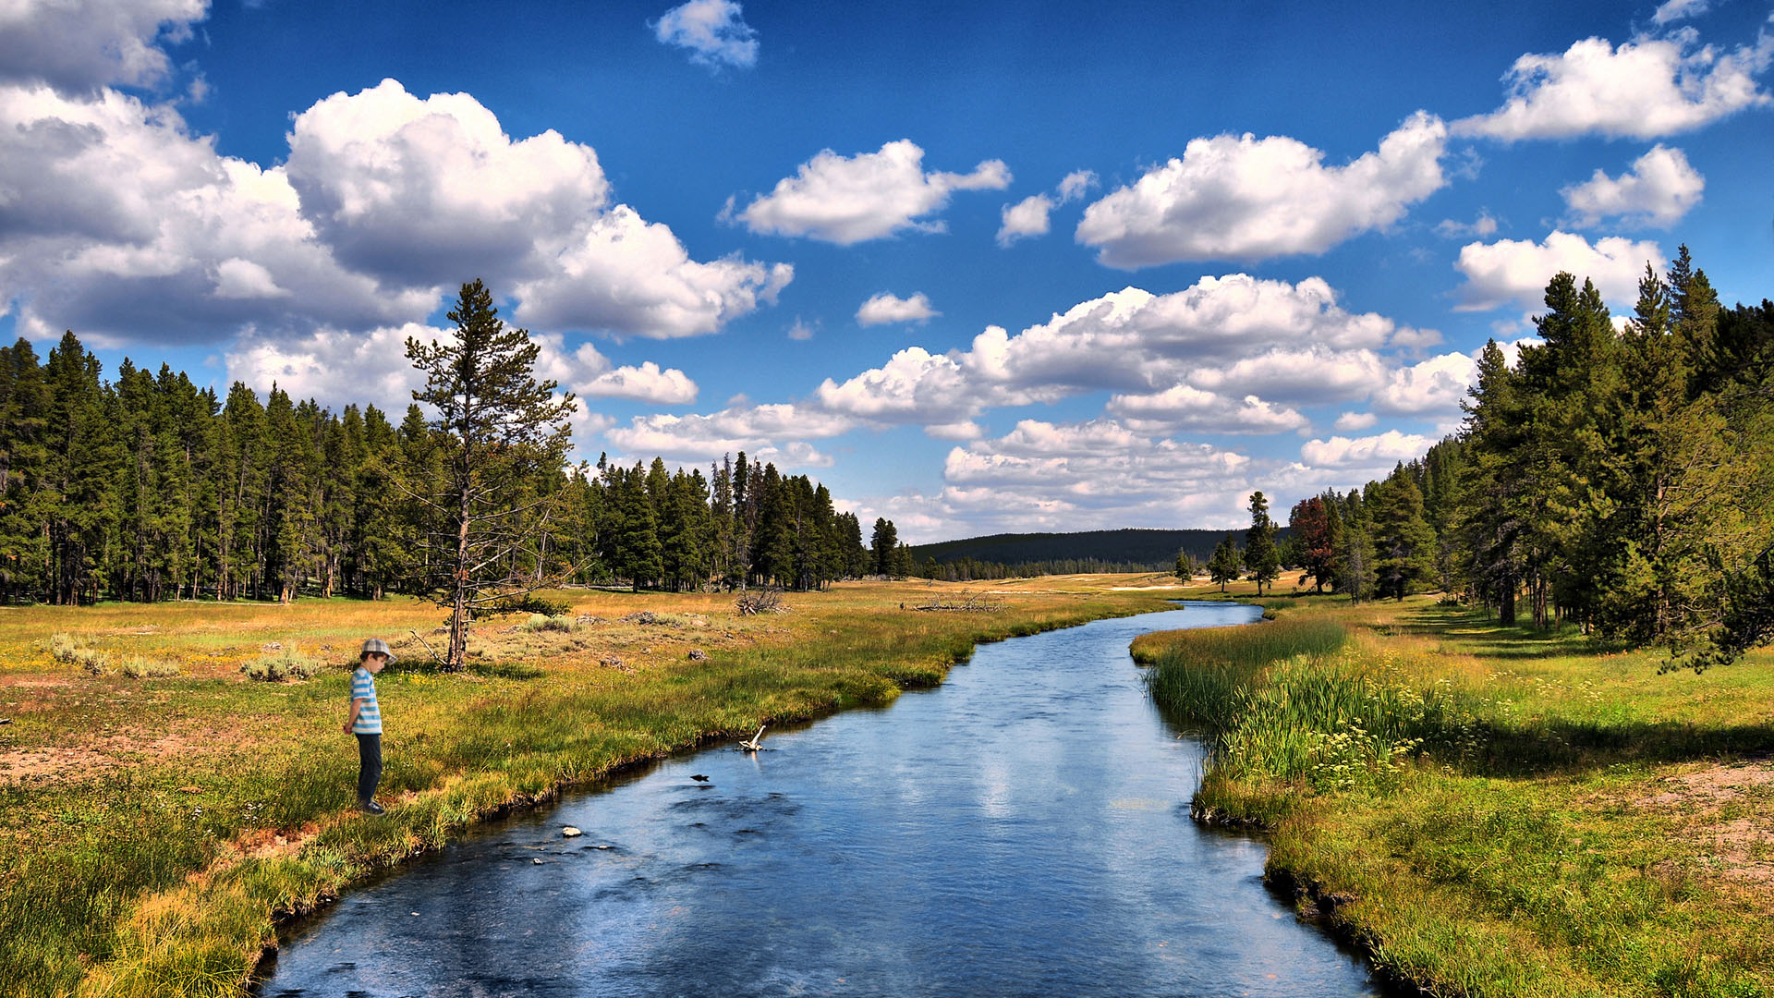
It is difficult and impractical to measure it with the help of a measuring tape.
How can we measure it ?
What is its width ?
?
RIVER

Slide 5
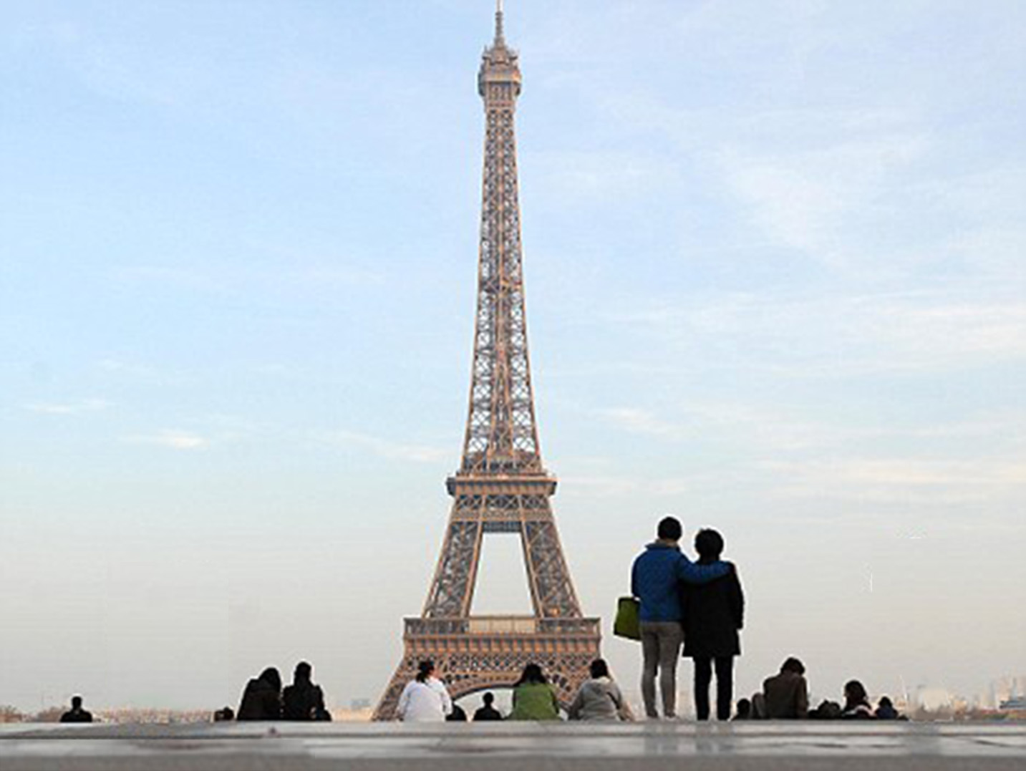
EIFFEL TOWER
It is impossible to measure it with the help of a measuring tape.
Hey…Its looking beautiful.
How can we measure it ?
?
Yes
What is its height ?

Slide 6


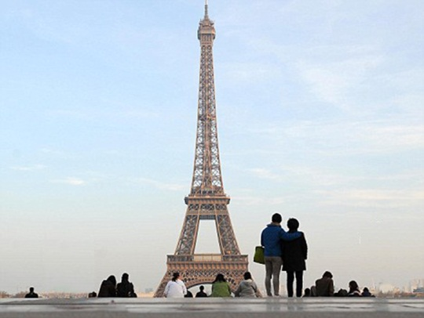
?
?
?
Such Heights and Distances can be found
by Applying TRIGONOMETRY.

Slide 7

We need to learn few important terms :
Line of sight
Horizontal line
Angle of Elevation
Angle of Depression
I am going to explain you all the important terms.
Hi…… !
I am Raj

Slide 8
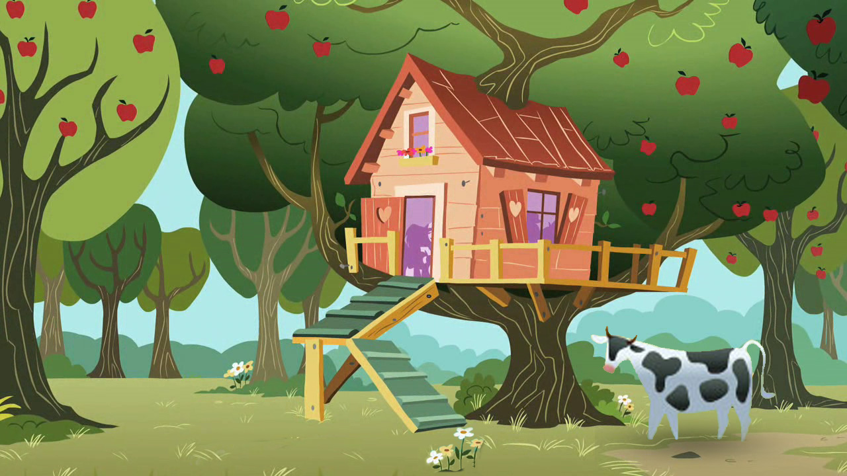



LINE OF SIGHT
Object
Line of sight
?
Object
I am observing the cow
I want that apple
Now, I am observing the beautiful flower
Line of sight
?
Object
Observer
Observer
Observer
Observer
Line of sight
This imaginary line is connecting the eye of the observer and the object.
?
Line of sight
Let us see few more examples
This line is called ‘Line of sight’
Now, I am observing the door of the tree house
Object

Slide 9

Object
ANGLE OF ELEVATION
: Remember : Angle of Elevation is formed, when the object is above the horizontal line.
Is this line of sight making an angle with the horizontal line?
This angle is called as ‘Angle of Elevation’.
YES
Line of sight
?
I am observing the top of the tree.
Observer
θ
Horizontal line
This line passes through the eye of the observer
This line is called ‘Horizontal line’.
and is parallel to the ground.

Slide 10

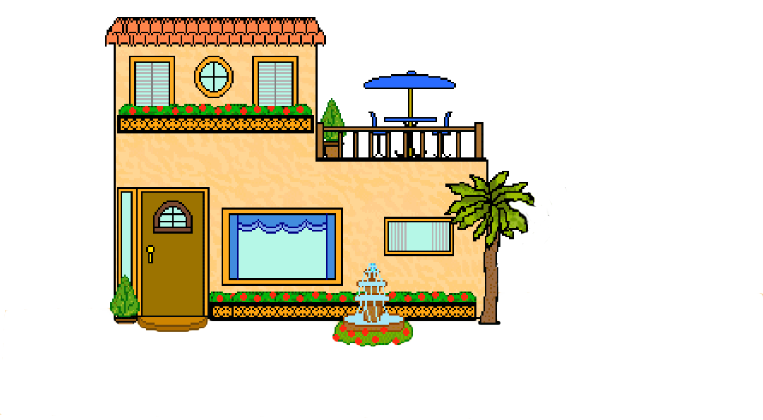



ANGLE OF DEPRESSION
I am observing the flower on the ground.
Observer
Horizontal line
?
θ
?
Line of sight
: Remember : Angle of Depression is formed, when the object is below the horizontal line.
Object
This angle is called as ‘Angle of Depression’.
Is this line of sight making an angle with the horizontal line?
YES

Slide 11
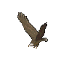



Let us revise all the four terms.
I am observing the flower on the ground.
I am observing the Eagle in the sky.
?
Object
Line of sight
Observer
Observer
Angle of Elevation
?
Horizontal line
?
?
Angle of Depression
?
Line of sight
Object

Slide 12
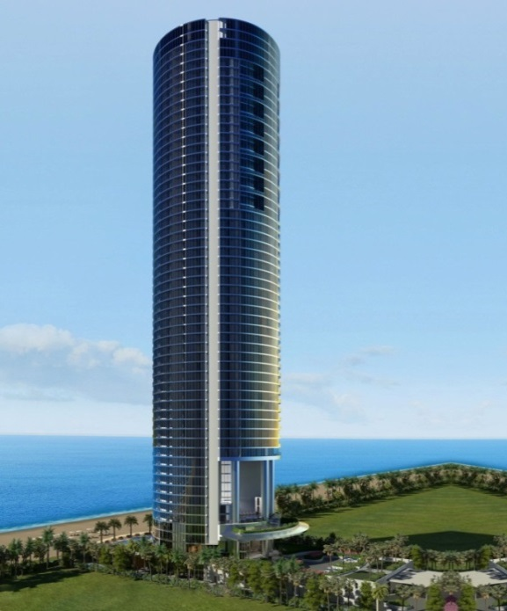
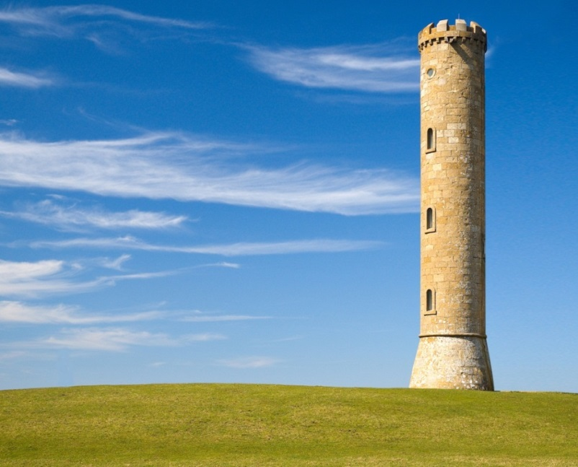

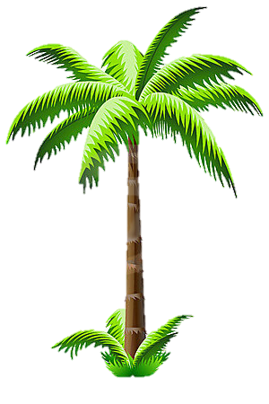
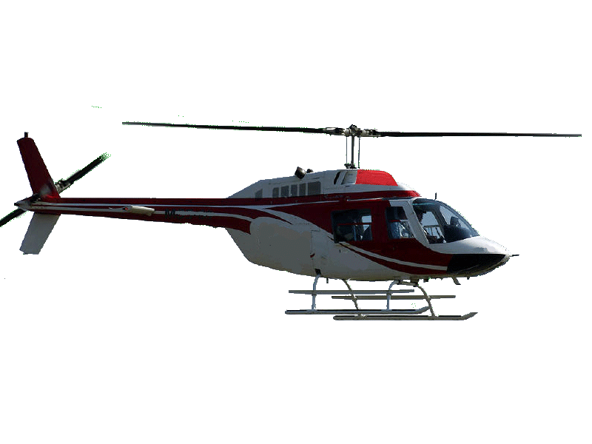
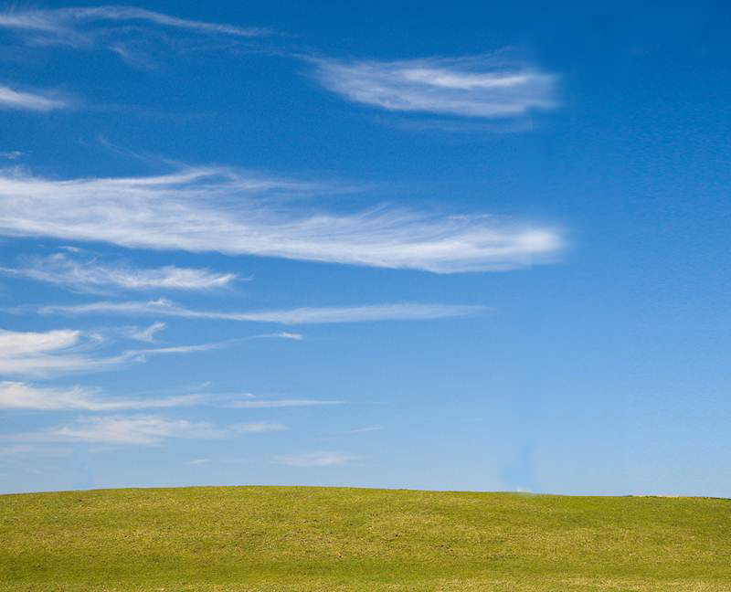
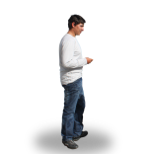
Points to be remembered while drawing the figures to solve the problems :
All the heights of objects such as towers, trees, buildings, etc.
shall be considered as a ‘line segment perpendicular to the ground’.
2. The height of the observer is neglected, if it is not given
in the problem. It shall be considered as a ‘point’.

Slide 13
Module 2

Slide 14
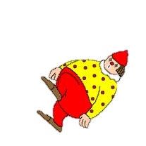
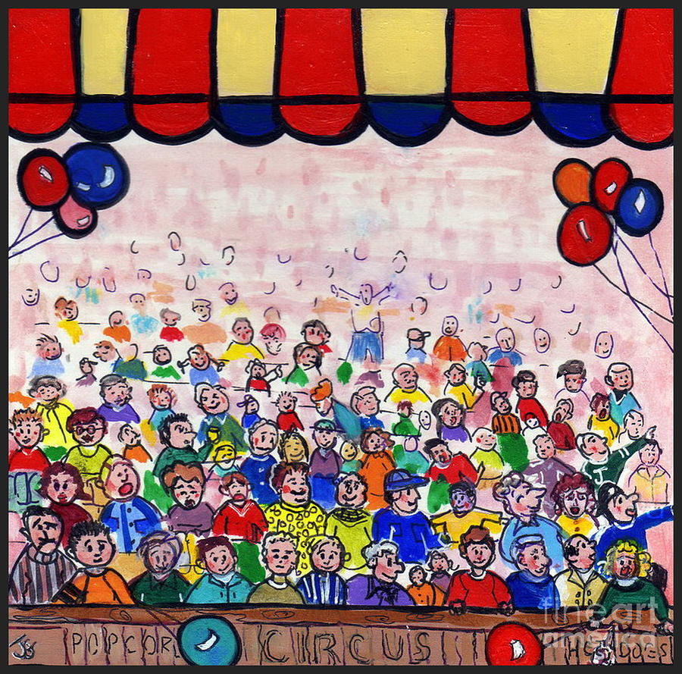
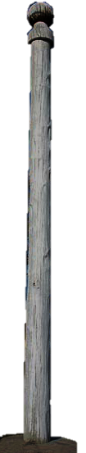
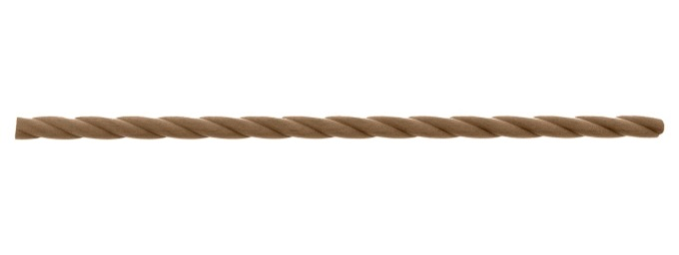
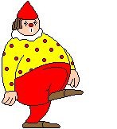
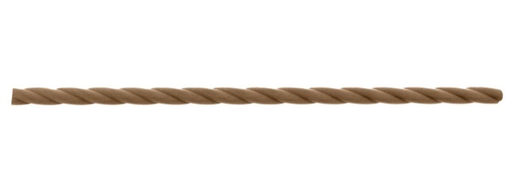
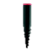
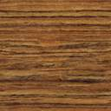

A circus artist is climbing a 20m long rope, which is tightly
stretched and tied from the top of a vertical pole to the ground.
Find the height of the pole, if the angle made by the rope with the ground level is 30º.
A
?
20 m
30º
B
C

Slide 15
A circus artist is climbing a 20m long rope,
which is tightly stretched and tied from the
top of a vertical pole to the ground.
Find the height of the pole, if the angle
made by the rope with the ground level is 30º.
A
For ‘∠C’
Ratio of opposite side and Hypotenuse reminds us of _________
hypotenuse
Observe ∠C
Opposite side →
AB
‘sin’
Opposite
side
?
20 m
Hypotenuse →
AC
h
Sol.
Length of rope (AC) = 20 m
1
sin 30º =
?
30º
Let the height of pole (AB) be ‘h’ m
2
In right ΔABC,
B
C
AB
sin 30º
=
AC
1
h
∴
=
2
20
∴
2h
=
20
20
∴
h
=
2
∴
h
=
10
∴
Height of the pole is 10 m

Slide 16
Module 3

Slide 17
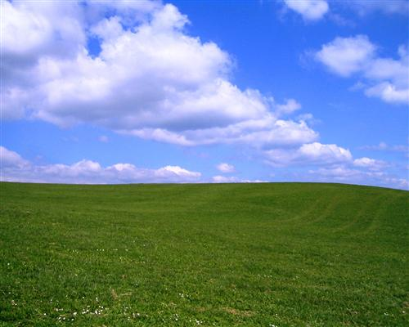
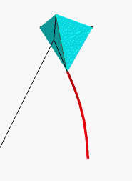
Q. A kite is flying at a height of 60m above the ground.
The string attached to the kite is temporarily tied to the ground.
The inclination of the string with the ground is 60º. Find the length of the string,
assuming that there is no slack in the string.
A
?
60 m
60º
B
C

Slide 18
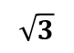

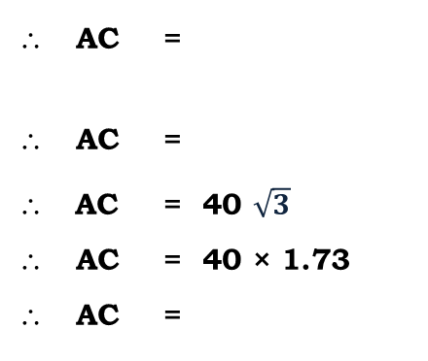
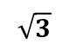
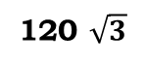
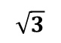
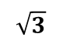
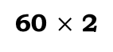
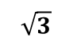
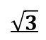


Q. A kite is flying at a height of 60m above the ground.
The string attached to the kite is temporarily tied
to the ground. The inclination of the string with
the ground is 60º. Find the length of the string,
assuming that there is no slack in the string.
A
Sol.
AB represents the distance of the kite from ground.
AB = 60 m.
AC represents the length of the string.
∠ACB = 60º
In right angled ΔABC,
sin 60º =
=
AC =
AC =
For ∠ACB
Opposite
side
Ratio of opposite side and Hypotenuse reminds us of _________
Now, let us rationalise the denominator
Observe ∠C
Hypotenuse
Opposite side →
AB
?
‘sin’
Hypotenuse →
AC
60m
60º
$$\sqrt{3}$$
B
C
sin 60º =
?
$$\sqrt{3}$$
2
120
∴ AC =
∴ AC =
∴ AC = 40 $\sqrt{3}$
∴ AC = 40 × 1.73
∴ AC =
$$×$$
$$\sqrt{3}$$
$$\sqrt{3}$$
AB
40
120 $\sqrt{3}$
AC
3
$\sqrt{3}$ = 1.73
∴
$$\sqrt{3}$$
60
2
AC
∴
60 $×$ 2
$$\sqrt{3}$$
69.2 m
∴
120
∴
$$\sqrt{3}$$
The length of the string is 69.2 m

Slide 19
Module 4

Slide 20
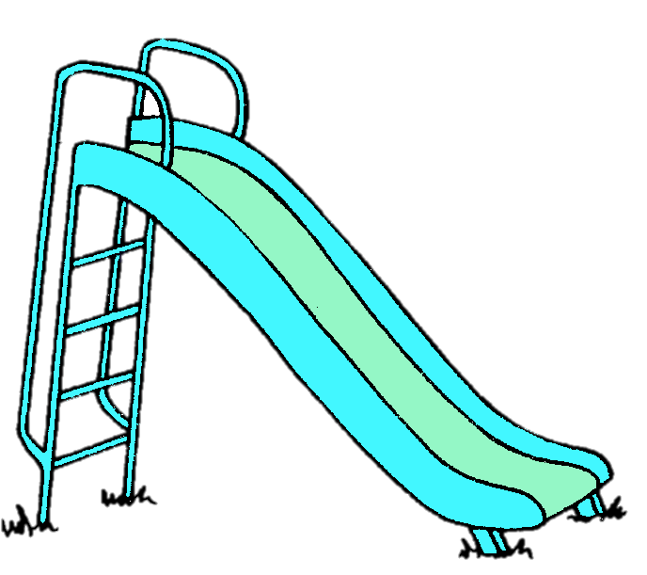
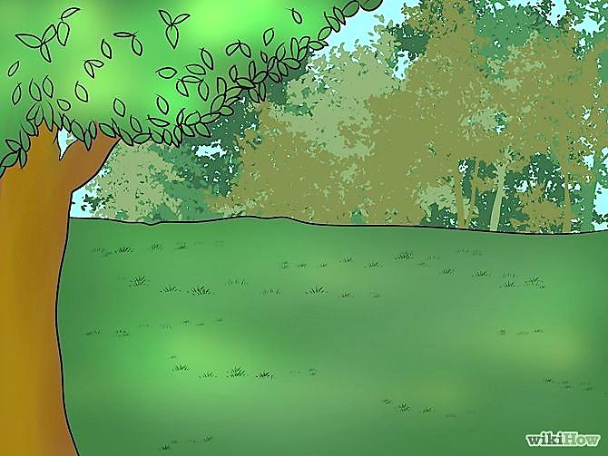
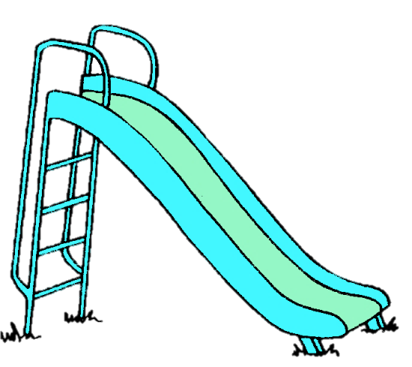


Q. A contractor plans to install two slides for the children to play in a park.
For the children below the age of 5 years, she prefers to have a slide whose
top is at a height of 1.5 m, and is inclined at an angle of 30° to the ground,
whereas for elder children, she wants to have a steep slide at a height of 3m,
and inclined at an angle of 60° to the ground. What should be the length of the
slide in each case?
P
A
?
3 m
?
1.5 m
Below
5 yrs.
30º
60º
B
C
Q
R

Slide 21
Q. A contractor plans to install two slides for the children
to play in a park. For the children below the
age of 5 years, she prefers to have a slide whose
top is at a height of 1.5 m, and is inclined at
an angle of 30° to the ground, whereas for
elder children, she wants to have a steep
slide at a height of 3m, and inclined at an
angle of 60° to the ground.
What should be the length of the slide in each case?
P
Observe ∠C
A
hypotenuse
For ‘∠C’
Ratio of opposite side and Hypotenuse reminds us of _________
?
Opposite side →
AB
?
3 m
y
x
Hypotenuse →
AC
1.5 m
‘sin’
Opposite
side
30º
60º
B
C
Q
R
1
Sol.
sin 30º =
?
2
Let the length of slide for the children
below 5 years (AC) be ‘x’ m
For small children :
In right ΔABC,
Length of slide for the elder
children (PR) be ‘y’m
AB
sin 30º
=
AC
1
1.5
Height of 1st slide (AB) = 1.5 m
∴
=
x
2
Height of 2nd slide (PQ) = 3 m
∴
x
=
1.5
× 2
∴
x
=
3

Slide 22
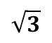
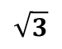
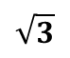

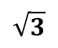

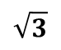
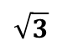
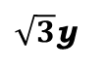
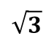
Q. A contractor plans to install two slides for the children
to play in a park. For the children below the
age of 5 years, she prefers to have a slide whose
top is at a height of 1.5 m, and is inclined at
an angle of 30° to the ground, whereas for
elder children, she wants to have a steep
slide at a height of 3m, and inclined at an
angle of 60° to the ground.
What should be the length of the slide in each case?
P
Opposite
side
hypotenuse
Ratio of opposite side and Hypotenuse reminds us of _________
A
Let us rationalise the denominator
For ‘∠R’
Observe ∠R
3 m
y
Opposite side →
PQ
3m
‘sin’
Hypotenuse →
PR
30º
60º
B
C
Q
R
$$\sqrt{3}$$
Sol.
sin 60º =
?
For elder children :
2
In right ΔPQR,
6
$$\sqrt{3}$$
∴
y
=
×
PQ
$$\sqrt{3}$$
$$\sqrt{3}$$
sin 60º
=
2
PR
$$\sqrt{3}$$
6
∴
y
=
$\sqrt{3}$ = 1.73
$$\sqrt{3}$$
3
3
∴
=
2
y
∴
y
=
$$\sqrt{3}$$
2
∴
$\sqrt{3}$y
=
3
× 2
∴
y
=
2 × 1.73
=
3.46
6
∴
y
=
∴
Length of slide for children below 5 years is 3 m
and length of slide for elder children is 3.46 m
$$\sqrt{3}$$

Slide 23
Module 5

Slide 24


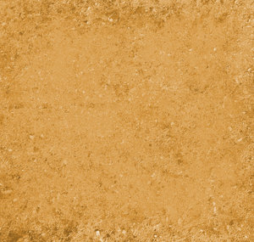
Q. The angle of elevation of the top of a tower from a point on
the ground, which is 30 m away from the foot of the tower, is 30°.
Find the height of the tower.
A
Top of
the tower
Height of the observer is neglected
line of sight
line of sight
?
Observer
30º
B
30 m
C

Slide 25
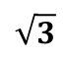
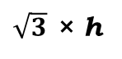
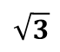
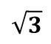
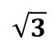


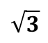


Q. The angle of elevation of the top of a tower from a
point on the ground, which is 30 m away from the
foot of the tower, is 30°. Find the height of the tower.
A
For ‘∠C’
Now, let us rationalise the denominator
Ratio of opposite side and adjacent side reminds us of _________
Observe ∠C
Opposite side →
AB
?
h
‘tan’
Opposite
side
Sol.
Adjacent side →
BC
Distance of the foot of the tower from a point on the
ground (BC) = 30 m
1
tan 30º =
?
30º
Let the height of pole (AB) be ‘h’ m
$$\sqrt{3}$$
B
30 m
C
In right ΔABC,
AB
Adjacent side
tan 30º
10
=
$$\sqrt{3}$$
BC
30
∴
h
=
1
h
3
$\sqrt{3}$ = 1.73
∴
=
$$\sqrt{3}$$
30
∴
h
=
$$\sqrt{3}$$
10
∴
$\sqrt{3}$ × h
=
30
∴
h
=
10
× 1.73
30
∴
h
=
∴
h
=
17.3
$$\sqrt{3}$$
∴
Height of the tower is 17.3 m
30
$$\sqrt{3}$$
∴
h
=
×
$$\sqrt{3}$$
$$\sqrt{3}$$

Slide 26
Thank You

